Slide 1
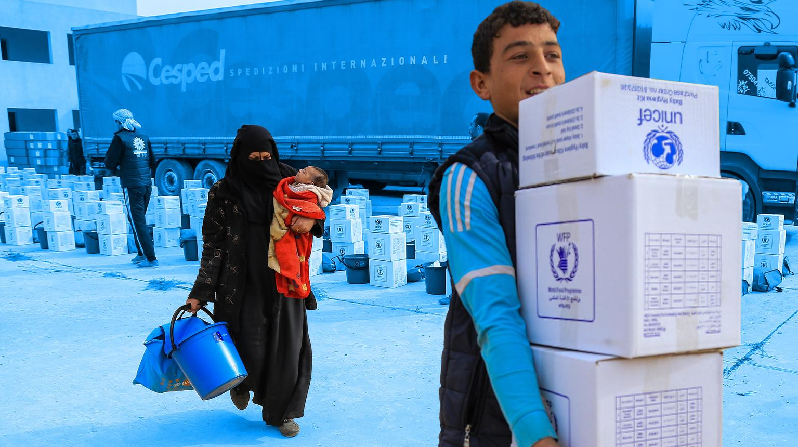
UN Partner Portal

Slide 2
What is the UN Partner Portal?
The UN Partner Portal is an online platform for UN agencies and civil society organizations (CSOs) to connect
UNPP supports the partnership selection process
UNPP simplifies and harmonizes UN processes for CSO partnership
UNPP is part of the suite of products

Slide 3
Who is Involved?

Slide 4
UNPP Benefits and Features
Feature | Value for UN Agencies | Value for CSOs
CSO Profiles | View CSO profiles (civil society mapping) | Create profiles to introduce their organizations to the UN (especially useful for national/local actors)
Partnership Opportunities | Post Calls For Expressions of Interest viewed by all CSOs (open selection) and partnership opportunities viewed only by intended CSOs (direct selection) | View “open selection” Calls For Expressions of Interest. Receive private notification of “direct selection” partnership opportunities.
Concept Notes | Receive and assess CSO concept notes (comparative advantage) | Submit concept notes to apply for “open selection” opportunities. Submit unsolicited concept notes to propose innovative ideas.
Partnership Offers | Provide feedback and make partnership offers | Receive UN feedback on concept notes and accept/decline UN partnership offers
Due Diligence | Conduct core values screening and share partnership observations with other UN agencies | Reduce duplication of paperwork for due diligence screening

Slide 5
How does UNPP fit in with other eTools modules?
Partnership
Lifecycle
Identification of CSO partner
Design and formalization of working relationship
Implementation, monitoring and reporting
Conclusion, suspension or termination
Offline/manual integration
eTools
Modules
UN Partner Portal (UNPP)
Offline discussion and negotiation
Offline PRC review
Partner Management Portal (PMP)
Partner Reporting Portal (PRP)
PMP
Financial Assurance Module
UNPP (observations)

Slide 6
User Roles in UNPP
UNPP has 4 user roles at UNICEF Country Office level:
UN Reader
UN Basic Editor
UN Advanced Editor
UN Administrator
UNICEF Regional Office colleagues can be granted user roles in multiple countries

Slide 7
User Role 1: UN Reader
 | User Permissions | UNICEF Staff Profile
 | View UN-published open and direct selection partnership opportunities View CSO profiles View verification status of CSO profiles View number—but not content—of observations added to CSO profiles Generate reports on CSOs | All UNICEF staff have access to UNPP, with user permissions set to the UN Reader role by default. Staff profile: Any staff member who is not subsequently assigned a different user role.

Slide 8
User Role 2: UN Basic Editor
 | User Permissions | UNICEF Staff Profile
 | All UN Reader permissions Add vendor number to CSO profiles Draft—but not publish—open and direct selection partnership opportunities View and assess CSO applications submitted for open selection partnership opportunities Recommend—but not select—CSOs for partnership Generate reports on partnership opportunities | UNICEF staff involved in day-to-day partnership processes at working level Staff profile: Programme Associate, Programme Officer, Operations Officer

Slide 9
User Role 3: UN Advanced Editor
 | User Permissions | UNICEF Staff Profile
 | All UN Reader permissions All UN Basic Editor permissions Publish open and direct selection partnership opportunities Select CSOs for partnership View number—and content—of observations added to CSO profiles Add new observations to CSO profiles Conduct due diligence and “verify” CSOs Generate reports on verifications, observations | UNICEF staff involved in oversight / management of partnership selection, who need to access or add sensitive risk observations. Staff profile: Section Chief, CFO, Deputy Representative, Chief of Operations

Slide 10
User Role 4: UN Administrator
 | User Permissions | UNICEF Staff Profile
 | All UN reader permissions Assign user roles to colleagues Deactivate users | Each UNICEF Country Office should have 1-2 staff members with this role, responsible for upgrading users from default UN Reader role to UN Basic/Advanced Editor role, based on instructions from Deputy Representative. Responsible for maintaining users as staff join or leave the Country Office. Staff profile: IT colleague

Slide 11
Suggested Allocation of User Roles
 |  | UN Reader | UN Basic Editor | UN Advanced Editor | UN Admin
CO | Deputy Representative |  |  | x
CO | Chief of Field Office |  | x | x
CO | Section Chief |  | x | x
CO | Programme Officer | x | x
CO | Programme Assistant | x | x
CO | Implementing Partnership / HACT Specialist |  | x | x
CO | ICTD |  |  |  | x
RO | Implementing Partnership/ HACT Specialist |  |  | x
either
or
either
or
either
or
either
or
either
or

